Slide 1
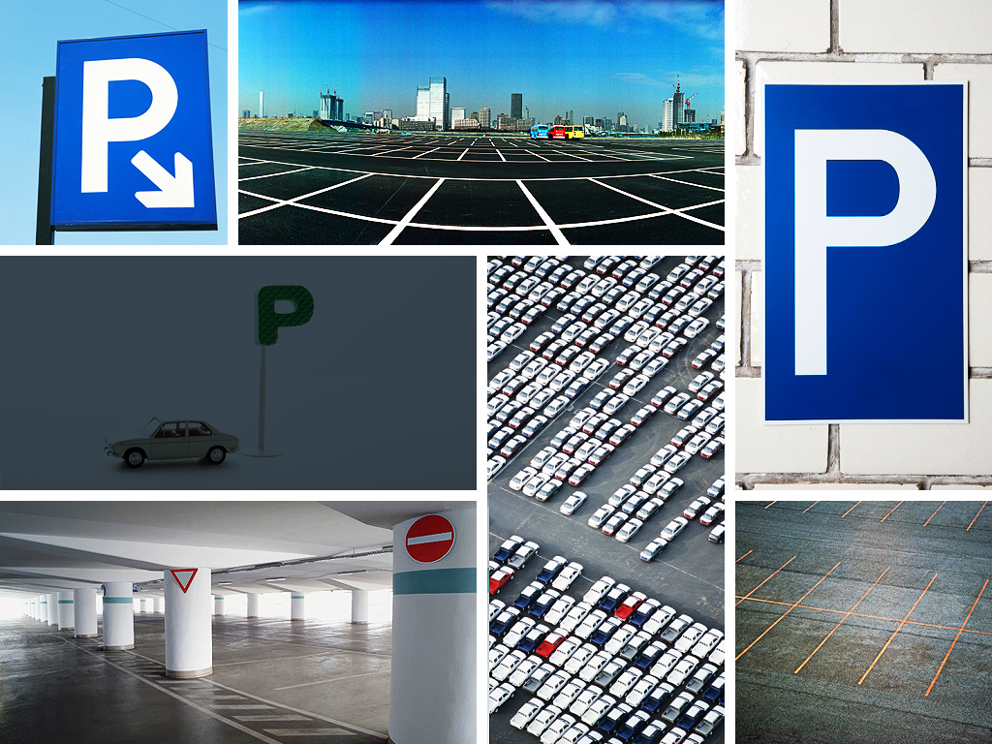
Design Parking Spots
Mahbubur Rahman
M.Sc in Data Science
Berliner Hochschule for Technik,
Berlin, Germany

Slide 2

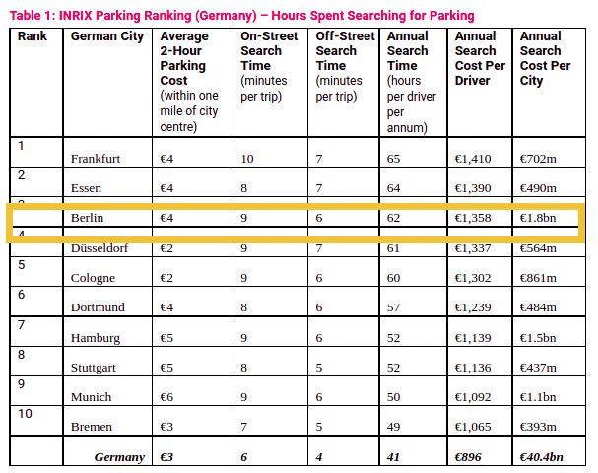
Use Case Study
Parking Pain
Source: https://www.parking-net.com/parking-news/inrix/germans-41-hours-searching-parking

Slide 3
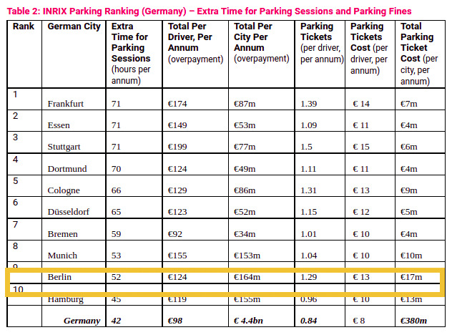
Use Case Study
Parking Pain
Source: https://www.parking-net.com/parking-news/inrix/germans-41-hours-searching-parking

Slide 4

Points to Present:
Analyze existing parking data
District Friedrichshain-Kreuzberg
District Neukölln
Predict parking spot’s capacity
Evaluate the predictive model
Future work

Slide 5
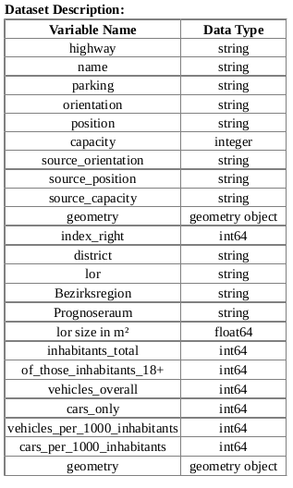
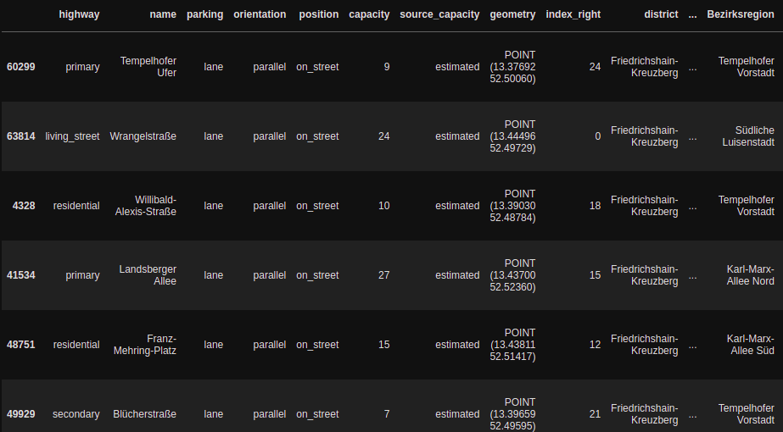


Analyze existing parking data:

Slide 6
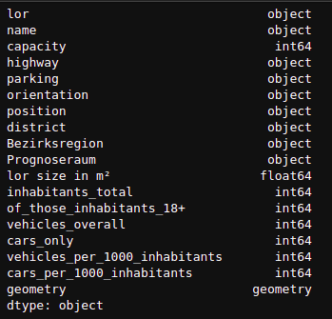
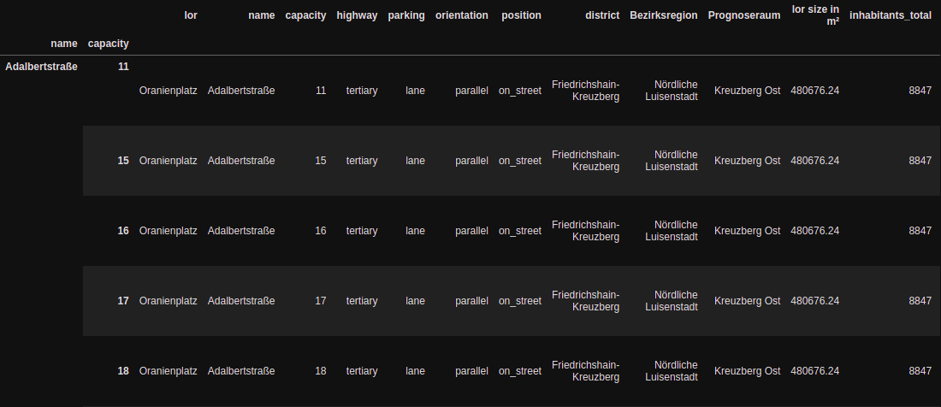
Analyze existing parking data:

Slide 7
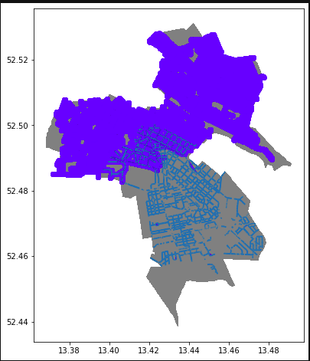
Analyze existing parking data:

Slide 8
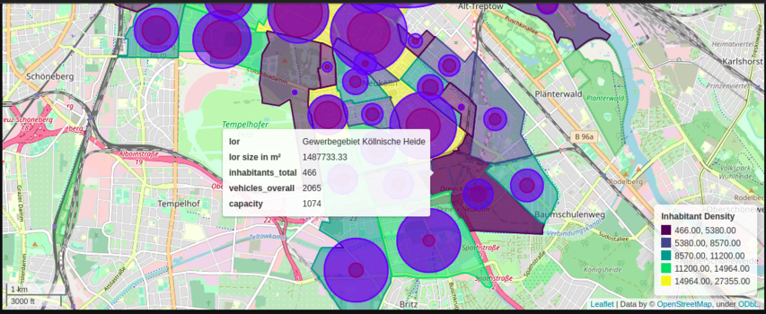
Analyze existing parking data:

Slide 9
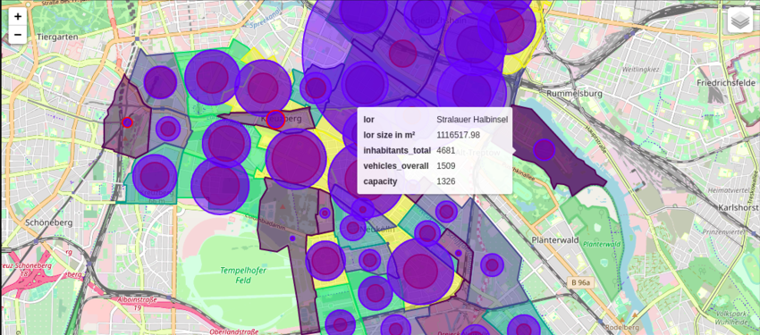
Analyze existing parking data:

Slide 10
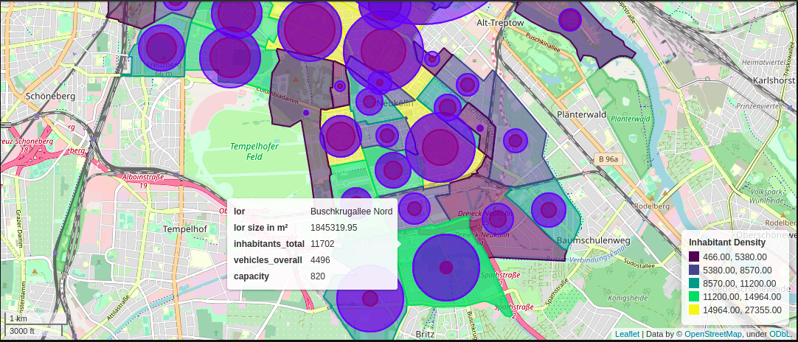
Analyze existing parking data:

Slide 11
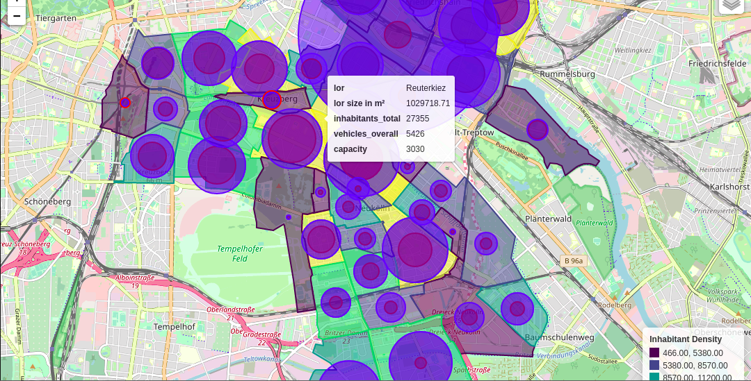
Analyze existing parking data:

Slide 12
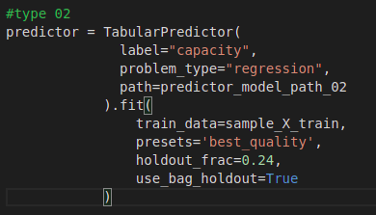

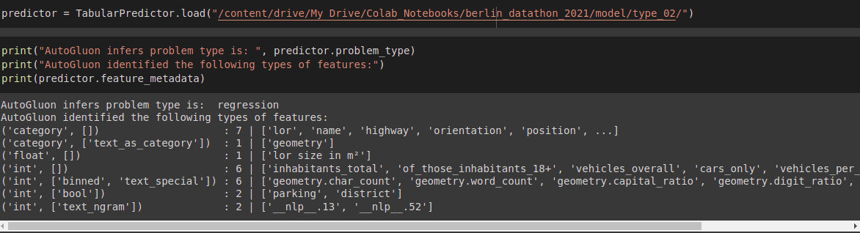
Predict parking spot’s capacity:

Slide 13
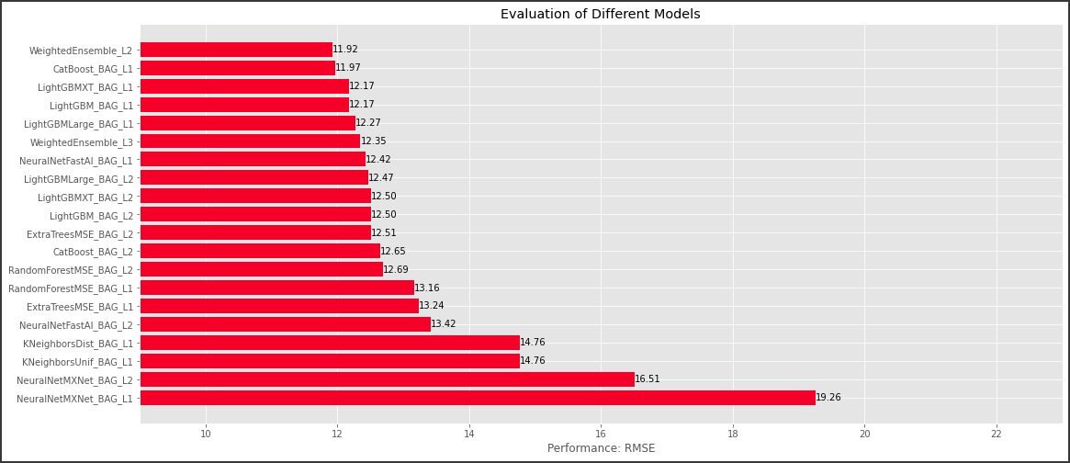
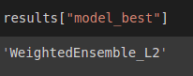

Evaluate the predictive model:

Slide 14
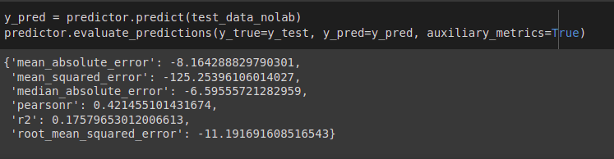
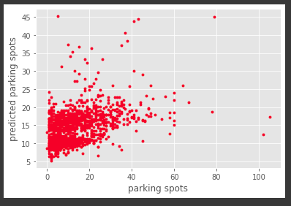
Evaluate the predictive model:

Slide 15
Future work:
Discussion and set goals to achieve.
Collect more data to increase volume.
Perform feature analysis.
Train the predictive model on fine tuned data.
Improve the predictive model quality.
Documentation of each steps for future contributors.

Slide 16
Credits:
Special thanks to Prof. Dr. Felix Bießmann for kind supervision.
Special thanks to City council people(District Friedrichshain-Kreuzberg and Neukölln) to provide datasets.
I designed the presentation from the PoweredTemplate.com. The template has Free License for guest users.
https://auto.gluon.ai/stable/tutorials/tabular_prediction/tabular-quickstart.html
https://pandas.pydata.org/docs/user_guide/index.html
https://geopandas.org/en/stable/getting_started/introduction.html

Slide 17

Question & Answer:
Source:
https://thumbs.dreamstime.com/b/discussion-complex-like-puzzle-pictured-as-word-discussion-puzzle-pieces-to-show-discussion-can-be-difficult-164222140.jpg

